Slide 1
ENERCON
2022
THE 3RD INTERNATIONAL CONFERENCE ON ENERGY AND ENVIRONMENTAL ECONOMICS

Slide 2
Deni Gumilang CASE Indonesia
Derisking Facilities to support Decarbonization Finance on the RE sector in Indonesia

Slide 3
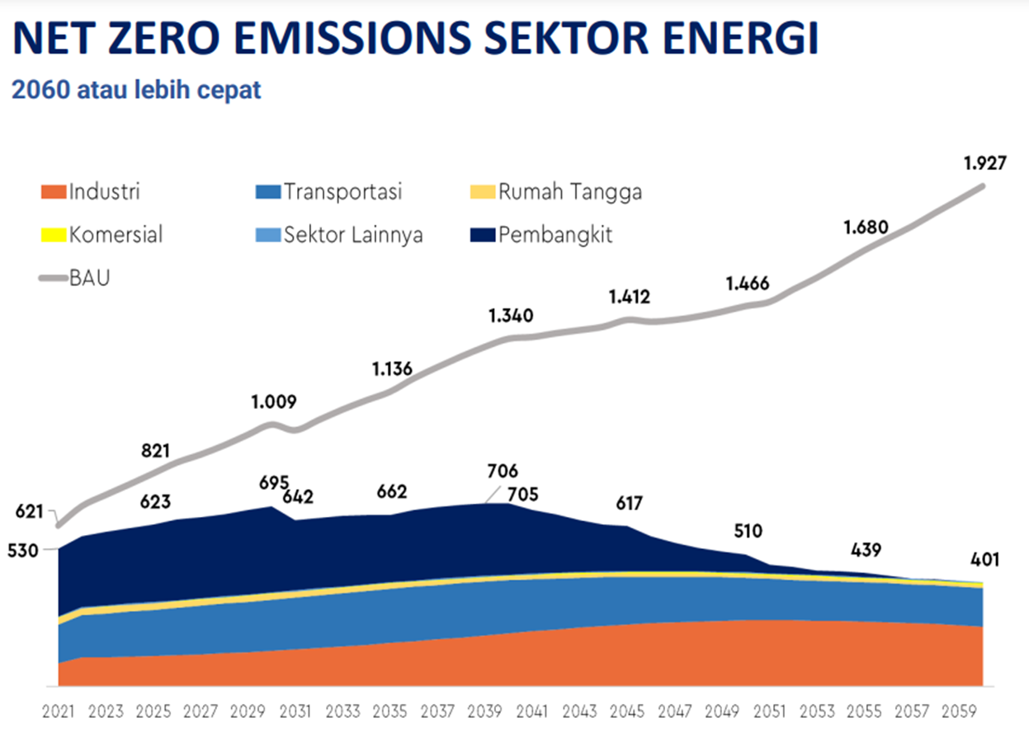
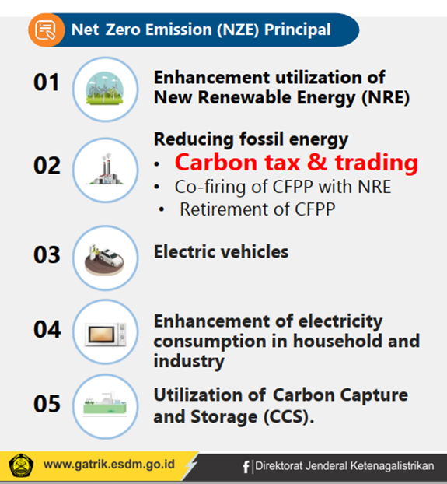
Indonesian Energy Transition - NZE
NZE Energy Sector (2060 or sooner)
Indonesia is following the global Trend of Strengthening the Climate Agenda and Energy Transition.
The Emission Levels in NZE scenarios 2060 (or sooner) are expected around 401 Million Tons of CO2.
Currently, the MEMR NZE Team is still doing a deepened modeling process of the roadmap for the target emission reductions by 2060 from the supply and demand side.
Source, MEMR 2022
Some of the issues in the exercise of the NZE model:
Coal phase-out plan
Acceleration of NRE development and Interconnection via super-grid as well as investment
Energy projections, production plans for oil and gas, coal and mining, as well as the electricity
Energy conservation opportunities and energy efficiency.
Meeting the NZE agenda requires enormous investment, and sustainable energy financing remains a daunting challenge for Indonesia. To support the ET, one of the NZE principal is through carbon tax and trading.
Source, MEMR 2021
ENERCON 2022

Slide 4
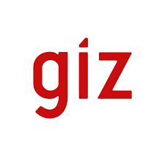
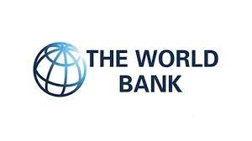
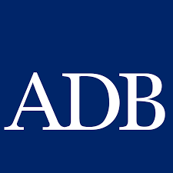
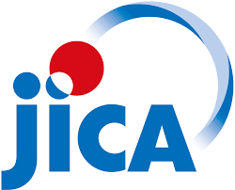
Bilateral/ Multilateral Donor Mapping and Identification support for ET
Regulatory Framework on RE & EE | Financing for RE & EE | RE Market Readiness | EE Market Readiness
Modelling, Outlook, Planning, Monitoring : IEA, DANIDA INDODEPP, GIZ AGEP, GIZ ExploRE, GIZ CASE, GIZ REEP2, UK MENTARI, USAID SINAR, ADB, UNDP ENTREV, EMOBILITY INDONESIA, WB, IRENA Regulatory Framework for RE and EE: UNDP & UNEP (GEF), IEA, IRENA, ADB, USAID SINAR, UK MENTARI, DANIDA INDODEPP, ETP Decarbonization: CASE, GIZ ExploRE, UK MENTARI, USAID SINAR, GGGI, ETP, ERIA Coal Phase Down: UNDP ENTREV, UNDP MTRE3, UNDP ADLIGHT, DANIDA, UK LCEP, UK MAGC, UK MENTARI, JET, CASE, IEA, ADB, ERIA Power Purchase Agreement: GIZ REEP2, ADB, INDODEPP (Danish Govt.), ADM CF/TLFF, ETP Fiscal and structural reform, fossil Fuel Subsidies: GIZ ExploRE, GIZ DRM, USAID SINAR, ETP Public-Private Partnership: ADB, Asia Catalytic Green Financing Facility, ETP Carbon Mechanism (Tax, Credit): UNDP, GIZ SPIPA, GIZ DRM, CASE, Just Transition: JET, IEA | Loan, Bond, Direct Investment: ADB, GCF, JICA, Asia Catalytic Green Financing Facility, ETP, SEACEF Project Preparation: UK MENTARI, USAID SINAR, ADB, CASE, GIZ ExploRE, Asia Catalytic Green Financing Facility, OECD, UNDP Innovative Financing: USAID SINAR, CASE, GIZ ExploRE, UNDP & UNEP (GEF), Asia Catalytic Green Financing Facility, ETP, EUPP & ERPP Financial De-risking: World Bank, CASE, ETP, OECD CEFIM, GGGI, UNDP Coal Phase Out Finance: ADB, World Bank, ETP | Grid Strengthening: GIZ REEP, USAID SINAR, ADB, UK MENTARI, DANIDA INDODEPP, ETP Rural Energy Access: GIZ REEP, USAID SINAR, ADB, UK MENTARI, UNESCAP, SE4All Solar PV & Wind: DANIDA INDODEPP, GIZ REEP, GIZ ExploRE, CASE, UK MENTARI, USAID SINAR, ETP De-Dieselization: UK MENTARI, USAID SINAR, GIZ ExploRE, GGGI, ADM CF/TLFF, ETP Bioenergy: GGGI, GIZ ExploRE, CEM Green Hydrogen: UK MENTARI, GIZ ExploRE | EE in Buildings: DANIDA INDODEPP, UK MENTARI EE in Appliances: DANIDA INDODEPP, UNDP & UNEP (GEF), CLASP, ETP EE in Power Sector: ADB, DANIDA INDODEPP, ETP EE in C&I Sector: ECF EE in Downstream Industries (Textile, F&B): DANIDA, UNIDO EE in Energy Intensive Industries: USAID SINAR
Internal mapping by GIZ (Ardian Candraputra, Deni Gumilang, Dody Setiawan - 2022)

Slide 5
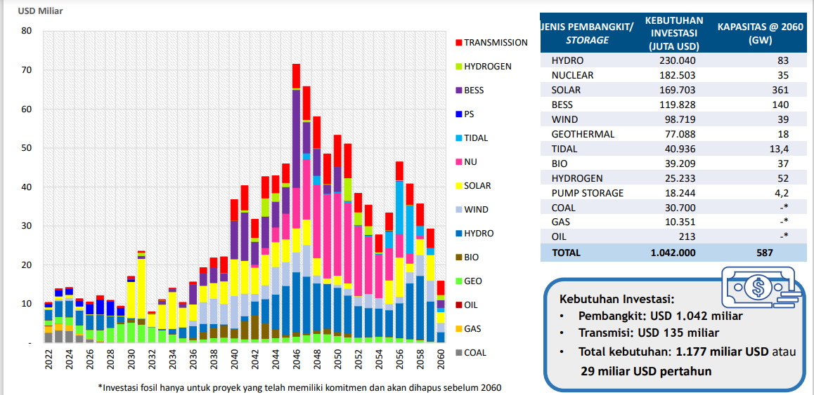
Investment for the Energy Transition
Despite the progress in clean energy financing in the last couple of years, the existing financing instruments and modalities from the public and private sectors are still perceived as insufficient to meet the need.
The current financial instruments are currently limited functionally available. There are some gaps and opportunities in the financing instruments from Fis, MDBs, private investors, and local financial institutions. There are many risks and underlying barriers that lead to higher costs. the finance is perceived only available for the demonstration stage but not yet go beyond the commercial/mass deployment stage. Policy and financial de-risking instruments exist but are often unknown, hard to implement, or difficult to access.
Investment need (+transmission):
1.177 billion USD (29 billion USD/ year)
Source, MEMR 2022
ENERCON 2022

Slide 6
Potential De-risking Instruments
De-risking instruments address risks mainly related to clean energy, increasing its investment attractiveness and enabling more funding sources to develop the sector.
Policy De-risking Instruments
Financial De-risking Instruments
Address sectoral risks by seeking to remove the underlying barriers that are the root causes of the risks
Utilize policy and programmatic interventions to mitigate risks.
Transfer the financial risks of clean energy projects from financing institutions to other actors, such as public institutions & development banks
Usually in the form of financial products and/or arrangements
ENERCON 2022

Slide 7
Policy De-risking Instruments
Improving Clean Energy Target Clarity & Policy Coherence
Reforming Pricing & Subsidy Policies
Increasing Project Risk Management by Providing Ratings & Technical Support
Increasing Project Feasibility & Credibility by Facilitating Research, Project Development and Capacity Building
Creating Effective and Efficient Permit & Procurement Process
1
2
3
4
5
ENERCON 2022

Slide 8
Improving Clean Energy Target Clarity & Policy Coherence
Policy adjustment to improve clarity, consistency, coherence, and credibility is needed to address the inconsistency and the obscurity of Indonesia’s clean energy policy.
Summary of key risk issues:
Policies have different approaches, as RUEN (the reference document for RUKN) uses a top-down approach. At the same time, RUPTL is set in the bottom-up approach, employing different modeling & assumptions. Also, the relation with other critical related policies is important to be aligned.
As a result, plans are inconsistent with possibly different targets in detail. Methods with a top-down approach also often involve over-optimistic economic growth, demands, and capacity additions.
Unclarity still exists in defining the role, the responsibility, and the involvement of different stakeholders (government bodies, developers, financiers) to achieve clean energy targets.
Summary of Key Risk Issues
De-risking Policies
De-risking policies:
Investigating whether current clean energy policies are aligned, given recent development (update on new NDC, LTS-LCCR) and the changing nature of some policies (RUPTL, which is updated annually).
Adjustments to ensure the clarity, consistency, coherence, and credibility of national clean energy policies.
Outlining clear & detailed stakeholder engagement plans in developing clean energy based on the national energy policies.
V
Source: GIZ (2017), IESR (2018), UI (2021)
ENERCON 2022

Slide 9
Reforming Pricing & Subsidy Policies
Transitioning towards a more friendly pricing and subsidy policy can further lowers the barriers.
Summary of key risk issues:
• Unattractive and persistent changes in pricing policy
• MEMR Regulation 50/2017, as amended through 53/2018, determines a price ceiling policy for clean energy power in areas where the regional cost of electricity production (BPP) is more than the national average, preventing developers from entering the clean energy power market.
• Ceiling on consumer power prices and the domestic market obligation (DMO) on coal incentivizes The State Electricity Company (PLN) to lowers its cost by procuring power from fossil-fuel sources with lower prices to clean sources.
• There is a lack of incentives for clean energy relative to brown energies, as fossil fuels have been subsidized for years, and the government applies DMO on coal. It is also creating contribute to BPP being biasedly lower than the cost of clean energy powers.
Summary of Key Risk Issues
De-risking Policies
De-risking policies:
Policies that assist PT PLN in overcoming the governance or financial difficulties. It includes the effective management of incentives and financing provided by the government to increase the amount of clean energy.
Shifting pricing policies from not favoring the transition to clean energy (price ceiling for clean energy power, consumer power price ceiling, and price ceiling in coal DMO).
Creating a more appropriate subsidy policy by reducing subsidies from brown energy and adding subsidies to clean power. Carbon tax instruments may also serve as a catalyst to transition from brown energy.
V
Source: IESR (2019), MoEMR & MoF (2019), ADB (2020b), UI (2021)
ENERCON 2022

Slide 10
Creating Effective and Efficient Permit & Procurement Process
Streamlining permit process & improving the certainty of key procurement aspects are important to overcome the barriers of clean energy power development in Indonesia.
Summary of key risk issues:
The permit process can be lengthy & challenging to acquire (especially for projects that require significant land acquisition and extensive impact studies), unclear, and surrounded by the tendency for graft practices, causing time uncertainty, leads to increasing costs and financing obstacles.
There is uncertainty for procuring opportunities in alignment with the plans and the targets of RUPTL
Procurement assessment can be time-consuming, cumbersome for Independent Power Producers (IPPs), incurring high administration costs. PPA contract arrangement is based on negotiation, putting small-scale developers with lower bargaining power at a disadvantage
Impartial resolution of conflicts between IPPs and PLN is uncertain
Summary of Key Risk Issues
De-risking Policies
De-risking policies:
Streamlining clean energy permit process and enforce transparent practices, fraud avoidance mechanisms/control.
Providing more procuring opportunities for IPPs as outlined in the plans and the targets of RUPTL, with most developers are expecting more tender bid opportunities and the implementation of feed-in-tariff contracts.
Improving consistency in PPA contracts by providing contract standards to enhance efficiency and equity.
Improving the certainty of impartial dispute resolution between IPPs and PLN.
V
Source: GIZ (2017), ADB (2019), UI (2021)
ENERCON 2022

Slide 11
Increasing Project Risk Management by Providing Standards, Ratings, & Technical Support
The provision of standards, ratings, & technical support may help to address the asymmetric information and unanticipated risk problem in Indonesia’s clean energy power sector.
Summary of key risk issues:
With the niche market nature of clean energy powers, there is no formal standard for project development, resulting in asymmetric information problems in the sector.
Financiers are often unable to fully understand and verify the assessment results of outsourced consultants in the evaluation of the risk level of clean energy power projects.
Not all developers, especially the small ones, are able to inform potential financiers of their risk profile due to the inaccessibility of hiring consultants.
clean energy projects often experience the materialization of unanticipated risks, such as land acquisition, social & political resistance, and natural disaster events, that requires the assistance of relevant government agencies.
Summary of Key Risk Issues
De-risking Policies
De-risking policies:
Establishing a formal project assessment standard as a best-practice reference for risk evaluation.
Providing a rating on clean energy projects and a rating or other forms of evaluation on the credibility of assessment consultants.
Ensuring the availability of relevant public institutions in providing technical support during risk assessment and mitigation.
Developing pilot models for the mitigation of common project risks.
V
Source: GIZ (2017), UI, 2021
ENERCON 2022

Slide 12
Enhancing Project Feasibility & Credibility by Facilitating Research, Project Development, and Capacity Building
Research, project development, and capacity building can reduce the risks during development phase, prevent possible decrease in competitiveness, and enhance the credibility of local developers
Summary of key risk issues:
Developers often face the highest level of risk during the development phase when an unsuccessful development attempt may immediately turn into a sunk cost.
Additionally, project development facilities is important but often too costly for private developers to conduct on their own.
Concerns are often raised on the credibility of local small-scale developers in conducting clean energy power projects.
Summary of Key Risk Issues
De-risking Policies
De-risking policies:
Providing project development facilities, which mainly include development financing and technical assistance.
Research and development (R&D) facilities by providing fiscal incentives through the increase in public funding for clean energy (R&D) and technical supports including access to public research equipment, instruments, & personnel.
Project development research may also include government-supported exploration projects and the dissemination of national research findings.
Capacity building includes industry training, apprenticeship programs, industry conferences, and university programs to build skills in the clean energy sector (planning, construction, and operations & marketing).
V
Source: GIZ (2017), UI, 2021
ENERCON 2022

Slide 13
Over supply for climate and energy transition finance?
Contributor
Combination Scheme
Bilateral Schemes (e.g. TA, grants, soft loans, other supporting instruments from GIZ, KfW, UK FCDO, USAID, AUSAID, AFD, JICA, DANIDA, etc.)
Multilateral Schemes (e.g. TA, grants, soft loans, loans, other financial instruments from ADB, WB, UN Agencies, EIB, etc.
Combination Scheme
Contributions from Philanthropy, Foundations, NGOs, etc.
Combination Scheme
Regional Schemes (e.g. TA, grants, soft loans, loans, other financial supporting instruments from SEACEF, SEA ETP, etc.
Private Funds (Credits, Leasing, Bonds, Equity, Mezzanine, Special Collateral and startups, other from private companies, Fis, investors, etc.)
Combination Scheme
Public Funds (APBN, APBD, Fiscal Facilities from the central government, local governments, etc.)
Innovative Mechanisms (e.g. SDG Indonesia One, BPDLH, PPP, Geothermal Fund, Carbon Mechanism, Green Sukuk, from K/L, government institutions, LJK, BUMN, etc.
Key issues:
Institutionalization
Legal set up
Policy integration and the implementation
Capacity development
Combination Scheme
Energy Transition
ENERCON 2022

Slide 14
Financial De-risking Instruments
Guarantee Provision
Performance-based Lending
Asset Securitization
Green Bonds
Seed Capital
Convertible Grants
Asset Aggregation
Mezzanine Financing
Concessional Debt
ENERCON 2022

Slide 15
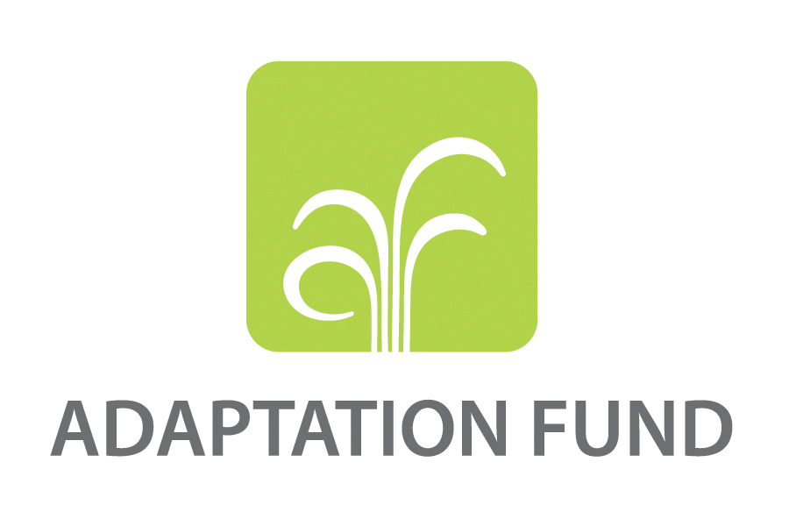
Innovative Fund, leveraging available fund to support advancing energy finance?
National
Global
UNFCCC Mechanism
Multilateral Mechanism
Indonesia is still in the earlier stage of the development of decarbonization.
Two instruments serve as appropriate tools to address clean energy development for decarbonization: policy de-risking instruments and financial de-risking instruments.
Currently, Indonesia needs to prioritize policy de-risking instruments over financial de-risking instruments due to the regulatory aspects issues in the clean energy sector. This presentation suggests policy de-risking is more critical and urgent to be solved.
The development of financial de-risking instruments should not wait until the policy and regulatory framework achieve their optimum shape. The financial de-risking instruments also need to be developed in parallel to create momentum. Once the policy de-risking instruments reach a stage of adequate "enabling environment," the financial instruments can channel the funds to finance the growth of clean energy sectors from potential investors.
Optimization of Climate Finance? Public-Private Partnership? Blended Finance? SDG Indonesia One? The role of PT SMI/ BPDLH as the catalyst? Etc; to accelerate the decarbonization process that combined with the development of ETM will help to create a sustainable energy finance.
Bilateral Supports/ Mechanisms
Regional Pool Fund/ Facilities
Other Financial Mechanisms (Including from Private, DFIs, IFIs, Philanthropies and Intl. NGOs)
Example of instrument:
Modification of fiscal facilities from the Ministry of Finance (Tax holiday, tax allowance, import duty facilities, etc.)
Innovative financing / other facilities (PISP funds, SDG Indonesia One, BPDLH instruments, global green Sukuk, retail green Sukuk, blended finance, etc.)
Financing through Government Cooperation with Business Entities (KPBU) or Public Private Partnership (PPP)
Financing through private partnerships with BUMN/BUMD with State Capital Participation (PMN)
Energy Transition Mechanism (Carbon Reduction Facility, Clean Energy Fund)
Multiple Direct Investments to Indonesia's SOE to implement Renewables by the Ministry of Finance
Private financing, etc
ENERCON 2022

Slide 16
ENERCON
Terima Kasih
Thank You
2022
THE 3RD INTERNATIONAL CONFERENCE ON ENERGY AND ENVIRONMENTAL ECONOMICS

Slide 17
Financial De-risking Instruments Availability
No | Financial De-risking Instruments |  | Availability in Indonesia | Potential
1 | Guarantee Provision | Guarantee plays an important role in financing the clean energy projects as most projects have underlying risks from the project itself to the financial and regulatory risks (EIU, 2011). Guarantee provision can manifest in the form of project guarantee and financial guarantee. | Limited availability in Indonesia | Highly potential to provide guarantee to investors. Could be in the form similar to PPP (KPBU)
2 | Performance-based Lending | The aims of PBL are to increase project developer’s accountability and give incentive to them to deliver good and sustained outcome of the projects. The key players of the instrument are lenders (usually private donors) and incentivized agent (developers). | Currently available in Indonesia ADB PBL proposed USD600 million result-based loan programs to support the development of electricity distribution for sustainability in Eastern Indonesia. | Highly potential and can expand the loan to private-owned clean energy energy projects
ENERCON 2022

Slide 18
Financial De-risking Instruments Availability
No | Financial De-risking Instruments |  | Availability in Indonesia | Potential
3 | Asset Securitization | Asset securitization can lower the liquidity risk of clean energy and increase investors’ appetite in investing to such projects. One of the asset securitization in Indonesia has been deployed by PT Sarana Multigriya Financial to finance infrastructure projects. However, financing through asset securitization has not been used for clean energy projects in Indonesia. | Currently not available in Indonesia | Highly potential for RE projects
4 | Green Bonds | Green Bonds serve as an alternative instrument that can facilitate and bridge the capital on the financial market to clean energy projects The development of the green bonds market can increase the accessibility of clean energy projectors to a bigger pool of funds. | Currently available in Indonesia The market is still small and lacks participation of private and foreign players. The bonds are still dominated by the government (70% of total green bonds issued) | Highly potential and need to increase private and foreign investors participation to have deeper green bonds market
ENERCON 2022

Slide 19
Financial De-risking Instruments Availability
No | Financial De-risking Instruments |  | Availability in Indonesia | Potential
5 | Seed Capital | Seed capital is money used for the initial investment in a project or start-up company, for proof-of-concept, market research, or initial product development (ADB, 2007). Seed capital is usually provided by the governments or Multinational Development Banks (MDBs). | Currently not available in Indonesia | Highly potential, especially for small-scale project developers
6 | Convertible Grants | A grant that is usually provided by the government or public finance institutions that can be converted into a loan. if it is unsuccessful, there is no financial commitment to repayment and the grants are not converted to loans. | Currently available in Indonesia - PT SMI (?) | Potential to be applied in RE projects
ENERCON 2022

Slide 20
Financial De-risking Instruments Availability
No | Financial De-risking Instruments |  | Availability in Indonesia | Potential
7 | Asset Aggregation | Aggregation in the clean energy sector is not limited to financial aggregation, but also demand aggregation, projects aggregation, and information aggregation. | Currently not available in Indonesia | Highly potential for small-scale RE projectors and HH
8 | Mezzanine Financing | Mezzanine financing is frequently associated with acquisitions and buyouts, for which it may be used to prioritize new owners ahead of existing owners in case of bankruptcy. Projectors usually seek mezzanine financing when bank debt is insufficient to finance the whole project. | Currently not available in Indonesia | Potential to be applied in RE projects especially when bank loan is insufficient
ENERCON 2022

Slide 21
Financial De-risking Instruments Availability
No | Financial De-risking Instruments |  | Availability in Indonesia | Potential
9 | Concessional Debt | Debt instrument which provides borrowers with upfront funding in exchange for repayment based on predetermined timeframes and interest rate terms | Currently available in Indonesia From MDBs like ADB who provides financial assistance for Indonesia’s geothermal project power project at Muara Laboh. | Potential to increase motivation of RE developers to complete their projects and fill the financing gaps of the projects
ENERCON 2022

Slide 22
Implementation of Potential De-risking Instruments for the Decarbonization
Indonesia is still in the earlier stage of the development of decarbonization.
Two instruments serve as appropriate tools to address clean energy development for decarbonization: policy de-risking instruments and financial de-risking instruments.
Currently, Indonesia needs to prioritize policy de-risking instruments over financial de-risking instruments due to the regulatory aspects issues in the clean energy sector. This presentation suggests that compared to financial de-risking instruments, policy de-risking is more critical and urgent to be solved as most policy and regulation challenges are still considered the main bottleneck of clean energy development in Indonesia.
The development of financial de-risking instruments should not wait until the policy and regulatory framework achieve their optimum shape. The financial de-risking instruments also need to be developed in parallel to create momentum. Once the policy de-risking instruments reach a stage of adequate "enabling environment," the financial instruments can channel the funds to finance the growth of clean energy sectors from potential investors.
Optimization of Climate Budget Tagging? Climate Change Fiscal Framework? Public-Private Partnership? Blended Finance? SDG Indonesia One? The role of PT SMI/ BPDLH as the catalyst? etc. to accelerate the decarbonization finance process.

Slide 23
Something to Think About
THERE IS NO SUCH THING AS ‘AWAY’. WHEN WE
THROW ANYTHING AWAY IT
MUST GO SOMEWHERE.
ANNIE LEONARD

Slide 24
Of greenhouse gas emissions come from buildings
125
100
75
50
25
0
Item 1
Item 2
Item 3
Item 4

Slide 25
GREEN BUILDING OVERVIEW
Presentations are communication tools that can be demonstrations, lectures, speeches, reports, and more.

Slide 26
References
IMPORTANCE OF GREEN BUILDING
Green Built Alliance (2018). Importance of Green Building.
Green Built Alliance. Retrieved from http://greenbuilt.org
GREEN BUILDINGS IN THE U.S. - STATISTICS
Statista (2018). Green Buildings in the U.S. - Statistics & Facts.
Statista. Retrieved from http://statista.com
ENERCON 2022

